Slide 1
Windows Azure Platform Overview
Name
Title
Company

Slide 2
What is the cloud?
An approach to computing that’s about internet scale and connecting to a variety of devices and endpoints
Notes:
Slide Objectives:
Explain how Microsoft thinks of the cloud
Speaking Points:
There are numerous terms and definitions floating around in the industry for “the cloud”, “cloud computing”, “cloud services”, etc.
Microsoft thinks of the cloud as simply an approach to computing that enables applications to be delivered at scale for a variety of workloads and client devices.
The cloud can help deliver IT as a standardized service…freeing you up to focus on your business

Slide 3
Allocated IT-capacities
Load Forecast
Not Enough Power
Too Much Power
IT CAPACITY
Actual Load
TIME
Notes:
Slide Objectives:
Understand the challenges of irregular load in applications
Understand the challenges of both too much capacity and not enough capacity and the sort of groups they impact within a customer
Understand that traditionally IT capacity is purchased in a stepwise fashion involving capital expenditure at each point
Speaking Points:
To understand the value and opportunity for cloud computing, I believe it’s important to think about how IT capacity is typically used by applications today in most environments.
Today most organizations significantly over estimate or underestimate the amount of resources they need to run their applications.
This leads to a higher cost for the infrastructure and the delivery of the overall applications.
Build Steps:
Forecast load is to grow steadily
Planned capacity grows in a stepwise fashion. Need to plan in advance due to hardware lead times
Actual load is highly variable over time
Periods where we have excess capacity. Capital laying idle, opex wasted powering and cooling servers
Periods where we have insufficient capacity and our customers get a bad experience

Slide 4
Load Forecast
No screaming customers
Capacity on Demand
IT CAPACITY
No capital laying idle
Knob goes up...
And...
down
Lower Capex
Actual Load
TIME
Notes:
Slide Objectives:
Understand that Windows Azure allows capacity to be turned on and off easily
Capacity can be brought on stream very quickly (no need to order servers in advance)
Speaking Points:
Lowers capex through not having to pay for hardware
Reduces waste of ovefr capacity
Ensures we can always provision enough capacity for peak periods
Can reduce capacity if demand subsides

Slide 5
Cloud Computing Patterns
“On and Off “
“Growing Fast“
Compute
Inactivity
Period
Compute
Average
Usage
Average Usage
Time
Time
On & off workloads (e.g. batch job)
Over provisioned capacity is wasted
Time to market can be cumbersome
Successful services needs to grow/scale
Keeping up w/ growth is big IT challenge
Cannot provision hardware fast enough
“Unpredictable Bursting“
“Predictable Bursting“
Compute
Compute
Average Usage
Average Usage
Time
Time
Unexpected/unplanned peak in demand
Sudden spike impacts performance
Can’t over provision for extreme cases
Services with micro seasonality trends
Peaks due to periodic increased demand
IT complexity and wasted capacity

Slide 6
Cloud Services
“IaaS”
“PaaS”
“SaaS”
Infrastructure-as-a-Service
Platform-as-a-Service
Software-as-a-Service
host
build
consume
Notes:
Slide Objectives:
Explain the three established terms in the industry for cloud services
Speaking Points:
With this in mind, it’s important to understand how to talk about our Cloud Services offerings.
There is a lot of confusion in the industry when it comes to the cloud.
It’s important that you understand both what is happening in the industry and how we think about the cloud.
This is the most commonly used taxonomy for differentiating between types of cloud services.
The industry has defined three categories of services:
IaaS – a set of infrastructure level capabilities such as an operating system, network connectivity, etc. that are delivered as pay for use services and can be used to host applications.
PaaS – higher level sets of functionality that are delivered as consumable services for developers who are building applications. PaaS is about abstracting developers from the underlying infrastructure to enable applications to quickly be composed.
SaaS – applications that are delivered using a service delivery model where organizations can simply consume and use the application. Typically an organization would pay for the use of the application or the application could be monetized through ad revenue.
It is important to note that these 3 types of services may exist independently of one another or combined with one another.
SaaS offerings needn’t be developed upon PaaS offerings although solutions built on PaaS offerings are often delivered as SaaS.
PaaS offerings also needn’t expose IaaS and there’s more to PaaS than just running platforms on IaaS.

Slide 7
Cloud Services
Packaged Software
Infrastructure
(as a Service)
Platform
(as a Service)
Software
(as a Service)
You manage
Applications
Applications
Applications
Applications
You manage
Data
Data
Data
Data
Runtime
Runtime
Runtime
Runtime
Managed by vendor
You manage
Middleware
Middleware
Middleware
Middleware
Managed by vendor
O/S
O/S
O/S
O/S
Virtualization
Virtualization
Managed by vendor
Virtualization
Virtualization
Servers
Servers
Servers
Servers
Storage
Storage
Storage
Storage
Networking
Networking
Networking
Networking
Notes:
Slide Objectives:
Explain the differences and relationship between IaaS, PaaS, and SaaS in more detail.
Speaking Points:
Here’s another way to look at the cloud services taxonomy and how this taxonomy maps to the components in an IT infrastructure.
Packaged Software
With packaged software a customer would be responsible for managing the entire stack – ranging from the network connectivity to the applications.
IaaS
With Infrastructure as a Service, the lower levels of the stack are managed by a vendor. Some of these components can be provided by traditional hosters – in fact most of them have moved to having a virtualized offering.
Very few actually provide an OS
The customer is still responsible for managing the OS through the Applications.
For the developer, an obvious benefit with IaaS is that it frees the developer from many concerns when provisioning physical or virtual machines.
This was one of the earliest and primary use cases for Amazon Web Services Elastic Cloud Compute (EC2).
Developers were able to readily provision virtual machines (AMIs) on EC2, develop and test solutions and, often, run the results ‘in production’.
The only requirement was a credit card to pay for the services.
PaaS
With Platform as a Service, everything from the network connectivity through the runtime is provided and managed by the platform vendor.
The Windows Azure Platform best fits in this category today.
In fact because we don’t provide access to the underlying virtualization or operating system today, we’re often referred to as not providing IaaS.
PaaS offerings further reduce the developer burden by additionally supporting the platform runtime and related application services.
With PaaS, the developer can, almost immediately, begin creating the business logic for an application.
Potentially, the increases in productivity are considerable and, because the hardware and operational aspects of the cloud platform are also managed by the cloud platform provider, applications can quickly be taken from an idea to reality very quickly.
SaaS
Finally, with SaaS, a vendor provides the application and abstracts you from all of the underlying components.

Slide 8
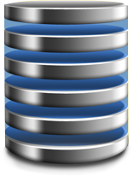
Windows Azure Platform
Scalable compute and storage
Automated service management
Familiar tools, technologies, languages
Relational storage for the cloud
Consistent development model
Automated database management
Connect existing apps to the cloud
Connect through network boundaries
Easily control authorization to apps

Slide 9
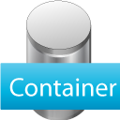
Windows Azure
Cloud Operating System
Compute
Storage
Virtual Network
Notes:
Speaking Points:
I suspect most if not all of you in this room are familiar with the Windows Azure Platform today.
Today the platform consists of a set of foundational services
SQL Azure relational database
AppFabric provides services that can be used by any apps – hosted in Windows Azure, on-premises, or hosted in another environment.
Questions:
How many of you are building applications for Windows Azure?
How many are using SQL Azure?
How many are using the Access Control service today? The Service Bus?
Notes:
Windows Azure Story
We are building an open platform to run your applications in the cloud. Your apps are .NET, Java, PHP, etc. We love everyone.
We are going to help you migrate your existing apps to the cloud.
The cloud platform is the future. Enables scale, self-service, lowers friction, etc. We provide the best cloud platform for building new apps. (aka n-tier, web services, etc.)

Slide 10
Hello Windows Azure
demo
Notes:
Recommended demos from the Windows Azure Platform Training Kit:
Hello Windows Azure

Slide 11
Demo: Hello Windows Azure
What you saw…
What Windows Azure provided
Simple ASP.NET app
Visual Studio 2010
Roles & instances are models in XML config
Local F5 debugging
Deployed to the cloud
New portal experience
Switched from staging to production
Environments to run your apps
Machines, rack space, switches, connectivity
Automated deployment & configuration
Isolation, redundancy, load balancing
Abstraction & Flexibility
Notes:
Slide objectives:
Summarize what the audience just saw with the Hello Windows Azure demo.
Speaking Points:
What you saw
So we just saw a number of things within this simple demo.
First you saw a simple ASP.NET web application, like many of you have built before.
We created the application using Visual Studio 2010, tools many of you are familiar with.
We were able to model the roles and instances for our Windows Azure application in a simple config file.
You saw how the Windows Azure development fabric provides a local environment for developing, debugging, and testing our applications – which is integrated directly with Visual Studio.
Finally, you saw how we could deploy our applications to Windows Azure and in a matter of minutes have the application running in the cloud and switch from staging to production.
What Windows Azure Provided
What is more exciting then this simple application is what you didn’t see, but what Windows Azure provided.
First, Windows Azure provided an environment to run code – to run our ASP.NET application.
It provided all of the infrastructure such as machines, rack space, connectivity, and switches.
It also automated and simplified the deployment and configuration. At no point did we have to remote into machines or FTP files or synchronize our application across machines. This automated service management was provided by Windows Azure.
Windows Azure also provided isolation for us – where our application is isolated from other apps that either we would develop or other organizations would develop.
We also saw how by simply specifying the number of instances in the service model, Windows Azure delivered key capabilities such as redundancy and load balancing for our application.
Ultimately, what this results in is abstraction and flexibility.

Slide 12
Windows Azure Storage
Scalable storage in the cloud
100tb per storage account
Auto-scale to meet massive volume and throughput
Accessible via RESTful Web Service API
Access from Windows Azure Compute
Access from anywhere via internet
Supporting .NET Client Library
Various storage types
Table - group of entities (name/value pairs)
Queue - Simple non-transactional message queue
Blob - Large binary storage
Drives - NTFS VHD mounted into Compute instance
Notes:
Slide Objectives:
Introduce Windows Azure Storage and some of the key features/capabilities of the storage service
Speaking Points:
The design point is for the cloud is availability of storage, there are 3 replicas of data, and we implement guaranteed consistency. In the future there will be some transaction support and this is why we use guaranteed consistency.
There are 4 types of storage
Tables = Key value store
Queues = a simple queuing mechanism
Blobs = Binary file storage in the cloud
Drives = A mechanism that allows a VHD in a blob to be mounted as an NTFS drive into a Compute role
Blobs, tables, and queues hosted in the cloud, close to your computation
Authenticated access and triple replication to help keep your data safe
Easy access to data with simple REST interfaces, available remotely and from the data center
Access is via a storage account – you can have multiple storage accounts per live id.
Although the native API is REST web service, there is a .NET storage client in the SDK that. This makes working with storage much easier from .NET

Slide 13
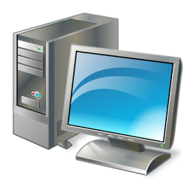
Windows Azure CDN
ECN NODE…
ECN NODE 2 - TOKYO
ECN NODE 1 - LONDON
Browse to cdn.customer.com GET foo.jpg
Windows Azure Storage
EDGE CACHING SERVERS
Enable CDN for
Storage account
Upload content
to public BLOB
Container
Create Storage Account via Portal
Enables a better user experience, global reach, increased engagement, more revenue
Broad reach with 22+ locations globally
Windows Azure
Customer
Notes:
Slide Objectives:
Understand basic concept of a CDN
Understand at a high level how Windows Azure CDN works
Speaking Points:
The Windows Azure CDN provides edge nodes around the world
Data stored in CDN enabled storage accounts is retrieved from the origin storage container and cached at each edge node in a lazy load fashion
Windows Azure Customers have control over how long data is cached for.
Windows Azure CDN has 20 locations globally (United States, Europe, Asia, Australia and South America) and continues to expand
The benefit of using a CDN is better performance and user experience for users who are farther from the source of the content stored in the Windows Azure Blob service.
Windows Azure CDN provides worldwide high-bandwidth access to serve content for popular events.
Notes
http://blogs.msdn.com/b/windowsazure/archive/2009/11/05/introducing-the-windows-azure-content-delivery-network.aspx

Slide 14
Windows Azure November 2010 Update
Windows Azure SDK & Tools 1.3
New Windows Azure Platform Management Portal
Remote Desktop
Multiple Service Administrators
Windows Server 2008 R2 & IIS 7.5
Full IIS
Elevated Privileges (Admin mode)
Windows Azure Virtual Machine Role
Windows Azure Connect (formerly “Sydney”)
Extra Small Virtual Machine Instances

Slide 15
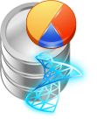
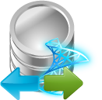
SQL Azure
Extending SQL Server to the Cloud
Database
Reporting
Data Sync
Notes:
Slide Objectives:
Introduction to SQL Azure
Explain SQL Azure Database
Indicate that other services are coming in the future
Speaking Points:
SQL Azure provides Microsoft SQL Server in the cloud
Broadly compatible with online SQL Server
In the future other services are planned
DataSync- to sync data between On premise and the cloud
Notes
Cloud-based relational database service built on SQL Server® technologies. It provides a highly available, scalable, multi-tenant database service hosted by Microsoft in the cloud. SQL Azure Database helps to ease provisioning and deployment of multiple databases. Developers do not have to install, setup, patch or manage any software. High availability and fault tolerance is built-in and no physical administration is required.
http://www.microsoft.com/windowsazure/sqlazure/
http://go.microsoft.com/?linkid=9686976

Slide 16
SQL Azure Database
Familiar SQL Server relational database model delivered as a service
Support for existing APIs & tools
Built for the cloud with high availability & fault tolerance
Easily provision and manage databases across multiple datacenters
SQL Azure provides logical server
Gateway server that understands TDS protocol
Looks like SQL Server to TDS Client
Actual data stored on multiple backend data nodes
Logical optimizations supported
Indexes, Query plans etc..
Physical optimizations not supported
File Groups, Partitions etc…
Transparently manages physical storage
Notes:
Slide Objectives:
Understand the key differentiators of SQL Azure
Understand where a user has control and where the cloud runs things
Speaking Points:
SQL Azure provides highly available SQL Server.
Appears to be a SQL Server to the client.
In reality is 3 transitionally consistent copies of the database that are fronted by a Gateway that appears to be a SQL server
Simple to provision- create a logical server in the Portal, execute a create DB Command to create a new database
Can add and remove DBs easily from application to scale up and down
Customers look after logical optimizations like indexes
SQL Azure manages the physical database
No need to install or patch software or other physical administration
Automatic high availability and fault tolerance
Simple provisioning and deployment of multiple databases
Scale databases up or down based on business needs
Multi-tenant
Integration with SQL Server and tooling including Visual Studio
Support for T-SQL based familiar relational database model
Notes
http://www.microsoft.com/windowsazure/sqlazure/
http://msdn.microsoft.com/en-us/windowsazure/sqlazure/default.aspx

Slide 17
Reporting & Data Sync
SQL Azure Reporting
SQL Server Reporting provided as a service
Reports authored using existing tools (BIDS) and uploaded to the cloud
Reports can have rich Data Visualizations (Maps, Charts, Tablix) and be exported to variety of rendering formats (Excel, Word, PDF)
Reports can be rendered as part of an app using the Report Viewer control
Directly view the reports in the browser
Web Service interface to render and manage reports
SQL Azure Data Sync
CTP1 available now provides geo-replication
CTP2 coming soon adds sync between SQL Server and SQL Azure
Builds on Sync Framework
Notes:
Speaking Points:
Another new service we’ll be introducing is SQL Azure Reporting.
With SQL Azure Reporting we’re effectively delivering SQL Server Reporting services….well, as a service
Again, you don’t have to install or manage software inside of machine instances.
Instead, you simply provision, configure, and use the service.
Reports can be authored using existing tools and then simply uploaded to SQL Azure Reporting
Notes:
Report developers can author reports against data in SQL Azure using existing tools
Reports can have rich Data Visualizations (Maps, Charts, Tablix) and can be exported to variety of rendering formats (Excel, Word, PDF)
Developers/ISVs can use SOAP Web Service APIs to view and manage reports
URL access to directly view reports in IE against the Reporting Service
Developers can embed Report Viewer control into Windows Azure application to render reports in connected mode

Slide 18
Windows Azure AppFabric
Building Block Services for developing connected applications
Service Bus
Access Control
Caching
Notes:
Slide Objectives:
Define and enumerate the Windows Azure Platform Appfabric
Speaking Points:
Much in the same way that SQL Services is about extending SQL Server to the cloud, we are also extending key .NET capabilities to the cloud as services.
We call this the Windows Azure AppFabric.
These services are really key components you would need for building distributed, connected applications.
When we talk about connecting to your existing on-premises applications and enabling the composition of hybrid (Cloud + on-premises) applications – that is where the AppFabric really comes in.
There are currently two AppFabric Services: the Service Bus & the Access Control Service
Service Bus:
The Service Bus is designed to provide a general purpose application bus, available on the internet at internet scale.
You can really thin of the Service Bus as being similar to an Enterprise Service Bus that many enterprise organizations have today.
However, we believe that when providing a Service Bus as a programmable service on the internet, there are a wider range of scenarios for many more types of organizations.
Fundamentally, the .NET Service Bus is about connecting applications across network and application boundaries and making key message exchange patterns such as publish and subscribe messaging very simple.
Access Control:
The Access Control service is designed to provide rules-driven, claims-based access control for applications.
Essentially, this allows you to define authorization rules for your applications using the claims-based approach that we are adopting within many Microsoft products and technologies and that is becoming adopted in the industry.
Notes:
Windows Azure has the .NET Framework built into it so that you can use those services within your application.
But just like your application must be designed to scale out, the services that we have built into Windows over time in .NET also need to be designed and built in a way that can scale out naturally. We want to create services for you, and that's the purpose of the AppFabric, creating a pool of resources available to you to take advantage of and do things within your application very simply.
So we're including a built-in, scale-out implementation of a service bus. The service bus lets you connect your on-premises systems securely into the cloud, into the Azure environment, while allowing your data and your information to traverse firewalls, solving a problem that is a bane of many application developments.

Slide 19
AppFabric Caching
Distributed, in-memory application cache for Windows Azure apps
Primary use cases
Session state provider for Windows Azure applications
Cache layer for Windows Azure applications that leverage storage in SQL Azure Databases or Windows Azure storage
Provided as a service
Provision, configure, and use
No installation or management of machines/instances
Dynamically increase and decrease cache size as needed
Same programming model for both cloud and on-premises
Notes:
Speaking Points:
One of the new services that we’ll be announcing next month at PDC is the AppFabric Cache Service
AppFabric Cache is a distributed, in-memory application cache for Windows Azure applications
There are two primary use cases for the AppFabric Cache
First, as a session state provider for Windows Azure applications
Secondly, as a data cache layer for Windows Azure Applications that use SQL Azure Databases or Windows Azure Storage
It’s important to understand that AppFabric Cache is provided as a service
Instead of having to install or manage software on machines or instances, you simply provision, configure, and use the service
This service abstraction also provides more flexibility – so you can dynamically increase or decrease the cache size as needed
Finally, with AppFabric Cache is uses the same programming model for both the cloud and on-premises with it’s on-premises equivalent being the Windows Server AppFabric Cache.

Slide 20
Windows Azure Marketplace
Apps
Find and publish applications and building block services for Windows Azure
Directory available in beta.
http://windowsazure.pinpoint.microsoft.com
Commerce capabilities coming in the future.
Data
Information marketplace for discovering, purchasing, & selling data
Data can be hosted in Windows Azure or by the data provider
Data exposed as OData services
Data providers include:
Data.gov, Navteq, Greg London, etc.
Directory & Commerce available today
http://datamarket.azure.com
Notes:
Speaking Points:
At PDC09 we introduced a new way to find and discover data called “Dallas”
Dallas is effectively a marketplace for discovering, purchasing, and selling data
Since the PDC we’ve been adding some new data providers and also improving the overall experience
At PDC10 in just a month we’ll announce the released version of Dallas along with new data providers, improved OData support, and a new portal.
One thing that is also interesting about Dallas is that it is entirely built on the Windows Azure Platform

Slide 21
Windows Azure Platform Data Centers
North America Region
Europe Region
Asia Pacific Region
N. Europe
N. Central – U.S.
W. Europe
S. Central – U.S.
E. Asia
S.E. Asia
6 datacenters across 3 continents
Simply select your data center of choice when deploying an application
Notes:
Slide Objective
Understand that Microsoft has a long history in running data centres and online applications. Bing, Live, Hotmail etc….
Understand the huge amount of innovation going on at the data center level
Speaking Points:
Microsoft is one of the largest operators of datacenters in the world
Years of Experience
Large scale trustworthy environments
Driving for cost and environmental efficiently
Windows Azure runs in 3 regions and 6 datacenters today
Data center innovation is driving improved reliability and efficiency
PUE = Power Usage Effectiveness = Total Facility power/IT Systems Power = Indication of efficiency of DC
Under 1.8 is very good, modern cloud DCs approaching 1.2
Multi-billion dollar datacenter investment
700,000+ square foot Chicago and the 300,000+ square foot Dublin, Ireland data centers
Microsoft cloud services provide the reliability and security you expect for your business: 99.9% uptime SLA, 24/7 support.
Microsoft understands the needs of businesses with respect to security, data privacy, compliance and risk management, and identity and access control. Microsoft datacenters are ISO 27001:2005 accredited, with SAS 70 Type I and Type II attestations.
Notes:
http://www.globalfoundationservices.com/
http://blogs.msdn.com/the_power_of_software/archive/2008/06/20/microsoft-s-pue-experience-years-of-experience-reams-of-data.aspx
http://blogs.msdn.com/the_power_of_software/archive/2008/06/27/part-2-why-is-energy-efficiency-important.aspx

Slide 22
Windows Azure Platform International Availability
Australia
Austria
Belgium
Brazil
Canada
Chile
Colombia
Costa Rica
Czech Republic
Cyprus
Denmark
Finland
France
Germany
Greece
Hong Kong
Hungary
Ireland
Israel
India
Italy
Japan
Luxembourg
Malaysia
Mexico
Netherlands
New Zealand
Norway
Peru
Philippines
Poland
Portugal
Puerto Rico
Romania
Singapore
Spain
Sweden
Switzerland
Trinidad & Tobago
UK
USA

Slide 23
Windows Azure Platform Appliance
Windows Azure Platform in your datacenter
Designed for unlimited scale & multi-tenancy
Identical to the hardware in Microsoft’s datacenters
Delivered by a choice of hardware partners
Benefits
Platform as a Service
Physical Control
Geographic Proximity
Regulatory Compliance
Data Sovereignty
Currently in development with several partners
Fujitsu, Dell, HP, and eBay

Slide 24
Windows Azure Platform Consumption Prices
Pay as you go and grow for only what you use when you use it
Elastic, scalable, secure, and highly available automated service platform
Highly available, scalable, and self managed distributed database service
Compute
Storage
Web Edition
Business Edition
Per GB stored and transactions
$9.99/month (up to 1 GB DB/month)
Starting at $99.99/month (10-50 GB DB/month)
Per service hour
Per database/month
Per database/month
$0.05-0.96/hour
+ Variable Instance Sizes
$0.15 GB/month
$0.01/10k transactions
Windows Azure AppFabric Service Bus and Access Control Service
Scalable, automated, highly available services for secure connectivity
Access Control
Service Bus
$1.99/10k transactions
$3.99/month per connection
Per Message Operation
Per Message Operation
Prices shown in USD only
International prices are available
Notes:
Slide Objectives:
Provide overview and detail on pricing
Discuss localization of pricing
Speaking Points:
Windows Azure is charged per compute hour.
Pricing is localized for global markets
Different VM sizes have a different number of CPUs and therefore are a multiple the single CPU rate
Compute time, measured in service hours: Windows Azure compute hours are charged only for when your application is deployed.remove the compute instances that are not being used to minimize compute hour billing. Partial compute hours are billed as full hours.
Storage, measured in GB: Storage is metered in units of average daily amount of data stored (in GB) over a monthly period.
Data transfers measured in GB (transmissions to and from the Windows Azure datacenter). Data transfers within a sub region are free.
Transactions, measured as application requests to the REST service
SQL Azure is priced on a per database per month basis
AppFabric Service Bus is based on a per connection model
AppFabric Access control is based on a per transaction model
AppFabric Service Bus connections can be provisioned individually on a “pay-as-you-go” basis or in a pack of 5, 25, 100 or 500 connections. For individually provisioned connections, you will be charged based on the maximum number of connections you use for each day. For connection packs, you will be charged daily for a pro rata amount of the connections in that pack (i.e., the number of connections in the pack divided by the number of days in the month).
You can only update the connections you provision as a pack once every seven days. You can modify the number of connections you provision individually at any time.
For AppFabric Access Control transactions, customers will be charged the actual number of transactions utilized for the billing period (i.e., not in discrete blocks of 100,000 transactions), plus data transfers in or out.
Notes:
http://www.microsoft.com/windowsazure/pricing/
http://blogs.msdn.com/b/netservices/archive/2010/01/04/announcing-windows-azure-platform-commercial-offer-availability-and-updated-appfabric-pricing.aspx
http://www.microsoft.com/windowsazure/pricing/

Slide 25
Summary
Windows Azure Platform is a comprehensive PaaS offering including:
Windows Azure
SQL Azure
Windows Azure AppFabric
Fundamental concepts:
Windows Azure Service Definition & Configuration
Windows Azure Roles
Commercially available today in 41 countries and 6 data centers
In the future Windows Azure & SQL Azure will be available on-premises as an appliance
Continuing to expand the set of services and features

Slide 26
© 2010 Microsoft Corporation. All rights reserved. Microsoft, Windows, Windows Vista and other product names are or may be registered trademarks and/or trademarks in the U.S. and/or other countries.
The information herein is for informational purposes only and represents the current view of Microsoft Corporation as of the date of this presentation. Because Microsoft must respond to changing market conditions, it should not be interpreted to be a commitment on the part of Microsoft, and Microsoft cannot guarantee the accuracy of any information provided after the date of this presentation. MICROSOFT MAKES NO WARRANTIES, EXPRESS, IMPLIED OR STATUTORY, AS TO THE INFORMATION IN THIS PRESENTATION.

Slide 27
Windows Azure Platform
Access Control
Service Bus
Caching
Database
Reporting
Data Sync
Compute
Storage
Management
Connect
Notes:
Speaking Points:
At PDC10 in just over a month, we will introduce several new services including: Caching and Reporting. We will also have a new CTP for the Data Sync Service and Project Dallas will be finally available.
Let’s drill into these services in a bit more detail.
--
Speaking Points:
I suspect most if not all of you in this room are familiar with the Windows Azure Platform today.
Today the platform consists of a set of foundational services
SQL Azure relational database
AppFabric provides services that can be used by any apps – hosted in Windows Azure, on-premises, or hosted in another environment.
Questions:
How many of you are building applications for Windows Azure?
How many are using SQL Azure?
How many are using the Access Control service today? The Service Bus?
Notes:
Windows Azure Story
We are building an open platform to run your applications in the cloud. Your apps are .NET, Java, PHP, etc. We love everyone.
We are going to help you migrate your existing apps to the cloud.
The cloud platform is the future. Enables scale, self-service, lowers friction, etc. We provide the best cloud platform for building new apps. (aka n-tier, web services, etc.)

Slide 28
Moving Apps to the Cloud
Compatible with Windows Azure
Designed for
Windows Azure
Delivered as a
Service
Applications can run in a Windows Azure VM role
Managed by the customer
Choice of deployment
Requires patching & maintenance of VMs
Uses the Windows Azure Service Model
Application managed by the customer
OS patching & maintenance provided by the platform
Faster deployment
Reliability and fault-tolerance
Managed by the ISV
Multi-tenant or isolated
Latest software for customers
Flexible business models (per user, subscription, etc.)

Slide 29
Windows Azure Web & Worker Roles
Windows Server 2008 x64 (R2 coming soon)
.NET Framework – 3.5 SP1 and 4.0
Native Code, PHP, Java, etc. – Bring your own runtime
Supports Full Trust today (admin mode coming soon)
Fabric manages role lifecycle
Worker Role
Web Role
Role is an executable
Create your own web server, host a database, etc.
Inbound on
Any TCP Port
HTTP/HTTPS
Role is hosted on IIS
HTTP/HTTPS
ASP.NET
Fast CGI + PHP
Notes:
Slide Objectives:
Understand Roles in general
Understand Web and Worker Roles at a high level
Speaking Points:
Windows Azure currently supports the following two types of roles:
Web role: A web role is a role that is customized for web application programming as supported by IIS 7 and ASP.NET.
Worker role: A worker role is a role that is useful for generalized development, and may perform background processing for a web role.
A service must include at least one role of either type, but may consist of any number of web roles or worker roles.
A worker role is started by a call to a well know managed code interface RoleEntryPoint. A worker role must extend this class and override the Start() method
A web role is a worker role with the addition of IIS being installed. i.e. it has all the features of and can do everything a worker role can do as well
Notes:
http://msdn.microsoft.com/en-us/library/dd179341.aspx#Subheading1

Slide 30
Full IIS
Web Roles previously using Hosted Web Core
Only supports a single HTTP or HTTPS endpoint
Web Roles now supporting Full IIS 7.0/7.5
Enables new scenarios
Multiple IIS web sites
Multiple virtual directories
Configure IIS extensions
Web Deploy for rapid development

Slide 31
New Windows Azure Platform Portal & Full IIS
demo
James Conard
Sr. Director
Microsoft Corporation
Notes:
7 min
Start in the new portal
Show the new Portal Experience for Windows Azure and SQL Azure
Multiple administrators
dunnry@hotmail.com – add as a buddy in messengerBrowse to the site
Browse to our app
Show how there are multiple sites running
? What happens if you browse using the default URL?
Show OS version and family
Mention is also in the service configuration
Show remoting into a machine
Mention that RDP works for all role types
Server 2008 R2
Point out that there are multiple sites in IIS
Switch to Visual Studio
Show how we enabled RDP in service config
Show how we have multiple sites in the service definition

Slide 32
Admin Mode & Startup Tasks
Enables short, unattended setups on role startup
Silent MSIs, COM Components, Registry Keys, Configuring Windows Server, etc.
Configured in the .csdef
Task Type
Simple – System waits for the task to exit
Background – System does not wait for the task to exit
Foreground – same as background, but blocks role restart until tasks exit
<WebRole name=“FabrikamShipping.App.Web">
<Startup>
<Task commandline="relative\path\ToSetupExecutable"
executionContext="limited|elevated"
taskType=“simple|foreground|background"/>
</Startup>
</WebRole>
Notes:
Consider explaining stages of roles
Role entry point
When tasks execute

Slide 33
Virtual Machine Role
Provided to help you move applications to Windows Azure
Enables you to have full control over the OS Image
Create your VHD locally
Upload the VHD to storage
Deploy a service package that uses the custom OS image
The role is your VM – Specify <OsImage href="20101020BaseVM.vhd" /> in the .cscfg
Key considerations
Image must be Windows Server 2008 R2 Enterprise
Designed for long or non-automated installs
No durability of OS image
You configure and maintain the Operating System
Currently available as a limited beta
Web/Worker Role
VM Role
Abstraction
Control

Slide 34
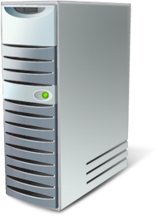
Windows Azure Connect
Secure network connectivity between on-premises and cloud
Supports standard IP protocols
Enables hybrid apps access to on-premises servers
Allows remote administration of Windows Azure apps
Simple setup and management
Integrated with WA Service Model
Web, Worker and VM Roles supported
Windows Azure
Enterprise

Slide 35
Windows Azure Connect
Windows Azure
Network policy managed through Windows Azure portal
Granular control of connectivity between WA roles and external machines
Automatic setup of IPsec
Tunnel firewalls/NAT’s through hosted SSL-based relay
Network policies enforced & traffic secured via end-to-end certificate-based IPSec
DNS name resolution based on endpoint machine names
Role A
Role B
Role C
(multiple VM’s)
Relay
Dev machines
Databases
Enterprise

Slide 36
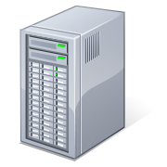
Working with SQL Azure Databases
Your App
SQL Azure
TDS
Change Connection String
Notes:
Slide Objectives:
Affirm that SQL Azure is just a TDS server. Existing SQL Server consumers can connect to it
Speaking Points:
Connecting to SQL Azure is simply a case of changing the connection string.
The SQL Azure fabric ensures 3 transitionally consistent replicas of your data
You will connect to a SQL Azure TDS gateway, this appears to be a SQL Server but will actually route your requests through to one of the three replicas stored in the DC
Avoid injection attacks by using the SqlConnectionStringBuilder class. It is available from the .NET Framework to simplify creating the connection string. For more information, see Connection String Builders (ADO.NET).
Carefully protect your connection string. A connection string presents a potential vulnerability if it is not secured. For more information, see Protecting Connection Information (ADO.NET).
In order to completely secure your connection, especially when connecting to SQL Azure over the Internet, insure that the ADO.NET Encrypt and TrustServerCertificate connection parameters are set.
For general considerations about connecting to databases in SQL Azure, see Guidelines for Connecting to SQL Azure Database.
More on security of SQL Azure in Day 3
Notes
http://msdn.microsoft.com/en-us/library/ee336243.aspx

Slide 37
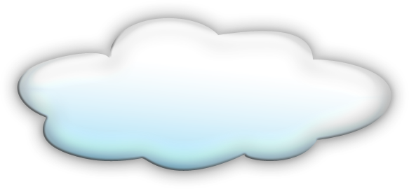
SQL Azure Data Sync
On-Premises
Cloud
Offline Clients
Geo-replication of SQL Azure data and spanning on-premises with cloud
CTP1 released in June with geo-replication
CTP2 to be released Q4CY10; adds sync between SQL Server and SQL Azure
Builds on Sync Framework
Sync data between SQL Azure, SQL Compact and SQL Server
Sync Fx 2.1 RTW on August 18th
Next version enables sync for offline clients

Slide 38
Monthly Service Level Agreement
Compute
connectivity
Instance monitoring and restart
Storage
availability
Database
availability
Service bus and access control availability
Your service is connected and reachable via web. Internet facing roles will have external connectivity
All running roles will be continuously monitored
If role is not running, we will detect and initiate corrective state
Storage service will be available/reachable (connectivity)
Your storage requests will be processed successfully
Database is connected to the internet gateway
All databases will be continuously monitored
Service bus and access control endpoints will have external connectivity
Message operation requests processed successfully
>99.95%
>99.9%
>99.9%
>99.9%
>99.9%
Notes:
Slide Objectives:
Explain the SLAs for the Windows Azure Platform
Speaking Points:

Slide 39
Windows Azure Storage
Tables
Table = group of entities
Entity = name/value pairs
Partitioned by key
Scale out to Bns of entities
Not an RDBMS
Blobs
Large binary storage
Stored in container
Unlimited containers
CDN Deliverable
Partitioned by Blob name
Queues
Simple message queue
Not transactional
Read at least once
Delete to remove message, otherwise is returned to queue
Partitioned by Queue Name
Drives
NTFS VHD mounted into Compute instance
Read/Write 1:1
Read only 1:N
Backed by Page Blob
Cannot remotely map
Notes:
Slide Objectives:
Understand each of the storage types at a high level
Speaking Points:
The Windows Azure storage services provide storage for binary and text data, messages, and structured data in Windows Azure. The storage services include:
The Blob service, for storing binary and text data
The Queue service, for storing messages that may be accessed by a client
The Table service, for structured storage for non-relational data
Windows Azure drives, for mounting an NTFS volume accessible to code running in your Windows Azure service
Programmatic access to the Blob, Queue, and Table services is available via the Windows Azure Managed Library and the Windows Azure storage services REST API
Notes:
http://blogs.msdn.com/b/windowsazurestorage/archive/2010/03/28/windows-azure-storage-resources.aspx

Slide 40
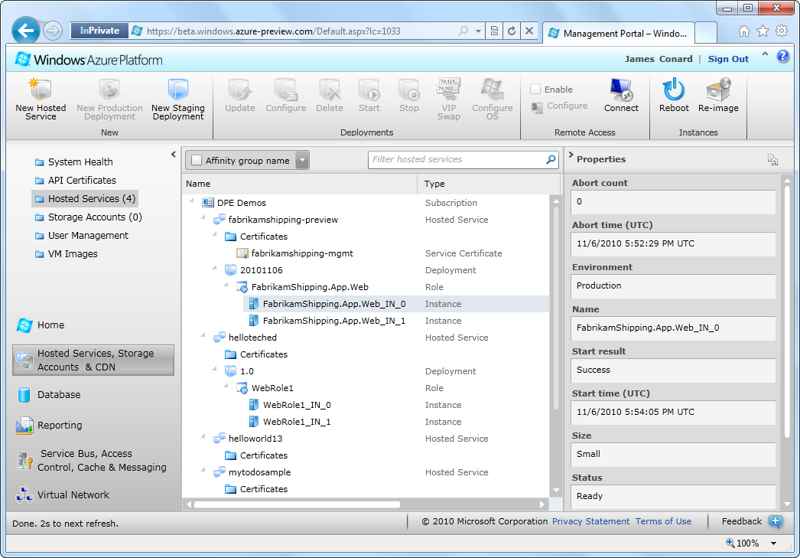
New Windows Azure Platform Portal
Faster and more user friendly portal for Windows Azure Platform services
More visibility and control
Supports multiple service administrators (co-admins)
Enable and connect to Windows Azure instances using Remote Desktop
Built on the Windows Azure Service Management APIs
Notes:
Speaking Points:

Slide 41
New Applications - New Challenges
Data Service
Data Service
Cache
Access Control
Reporting
ASP.NET
Data Service
Storage
Notes:
Speaking Points:
So if you think about what we’ve talked about so far, we are changing the landscape.
We believe that the way developers will be building apps is fundamentally changing. Instead of installing and managing software yourself, you can provision, configure, and use services.
Applications will consists of numerous services, some of which are provided by the platform – by Microsoft and some of which are provided by 3rd parties.
This new approach represents some new challenges as well. For instance,
How do you deploy the application as a single unit?
How do you upgrade the application as a unit?
How can you monitor the application and isolation issues when they occur?
How can you meter and track usage?
If you’re an ISV, how can you stamp out an instance of this application in a multi-tenant and cost-effective way for your customers?

Slide 42
AppFabric Composition Model
.NET-based declarative model for composing applications for the Windows Azure platform
Will enable you to define, deploy, and manage a cloud application as a single logical entity
Rich designer experience in Visual Studio
Runtime services in the cloud provide deployment & management of the application
Layers on the Windows Azure Service Model
Notes:
Speaking Points:
The Composition model is a .NET-based declarative way to represent an application – a complete application.
It will provide a way to compose, deploy, and manage an entire application as a single entity
It’s backed by a set of Visual Studio designers and tools as well as a .NET class library.
In the cloud there will be a set of runtime services that can deploy and manage a complete application for you.
Let me show you some screenshots of what we’re building. You’ll see a full demo on Thursday.
Notes:
Layers seamlessly on Windows Azure Service Model
Extends the core .NET value proposition
Model for composite applications – stateless and stateful
Rich designer experience in Visual Studio
Supports rich composition of artifacts across all tiers
End-to-end description across development, deployment, and management
Targets Windows Azure and Windows Server (not disclosed at PDC)

Slide 43
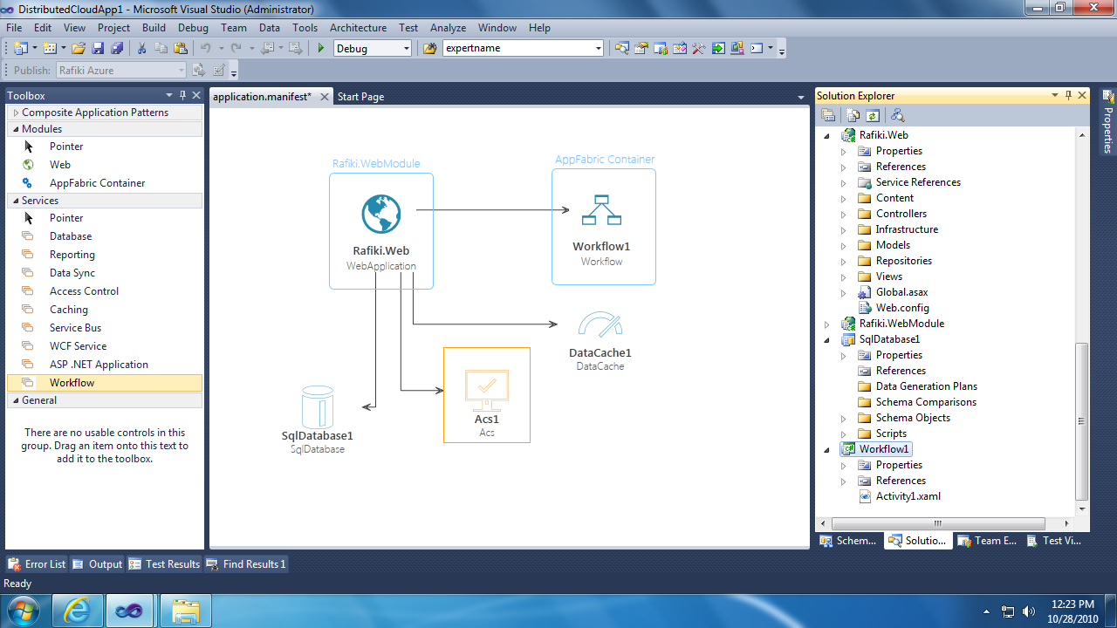

Slide 44
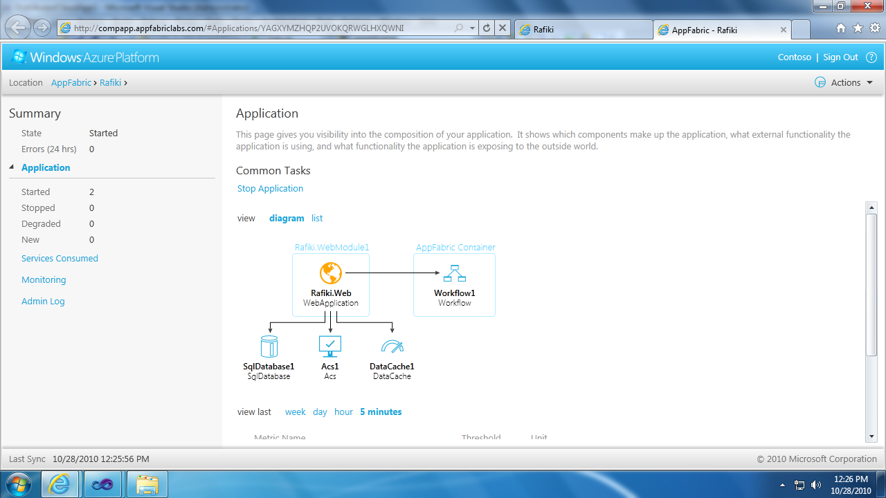
AppFabric Composition Model

